Slide 1
CS 355/555
Probability and Statistics for Computer Scientists
Baocheng Geng
Lecture 28, 04/16/2025
CS 355/555Probability and Statistics for Computer Scientists

Slide 2
Table of Contents
Central Limit Theorem
Covariance
Linear Regression
CS 355/555Probability and Statistics for Computer Scientists

Slide 3
Copyright Statement
Copyright Statement
Materials prepared for and/or included in this course are protected by copyright law. They are intended to be used only by students enrolled in this course during the current term and should not be further disseminated without prior permission from the course instructor.
CS 355/555Probability and Statistics for Computer Scientists

Slide 4
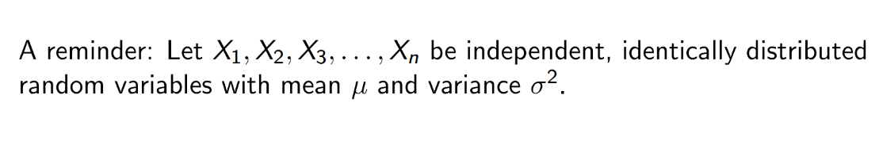
Central Limit Theorem
CS 355/555Probability and Statistics for Computer Scientists

Slide 5
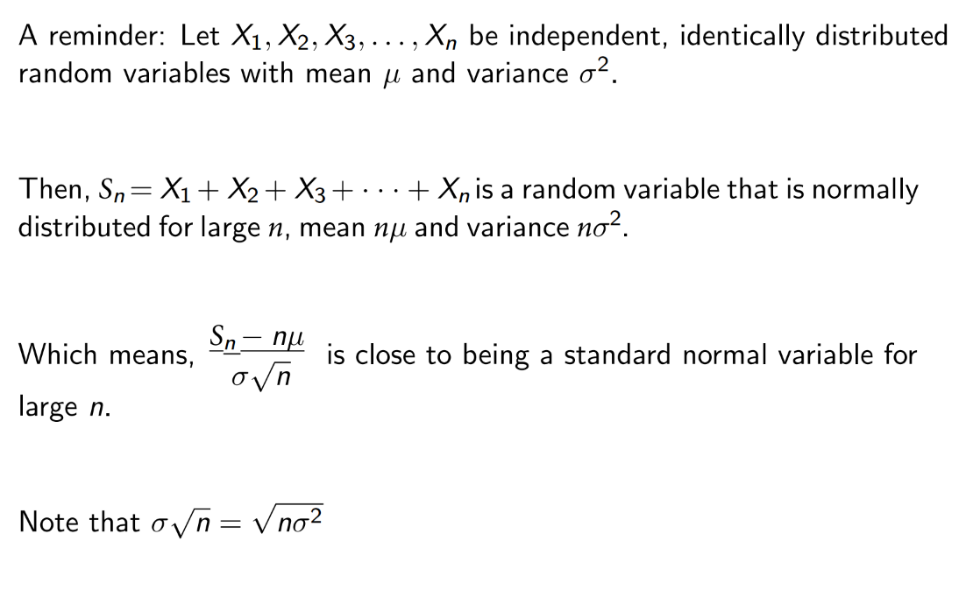
Central Limit Theorem
CS 355/555Probability and Statistics for Computer Scientists

Slide 6
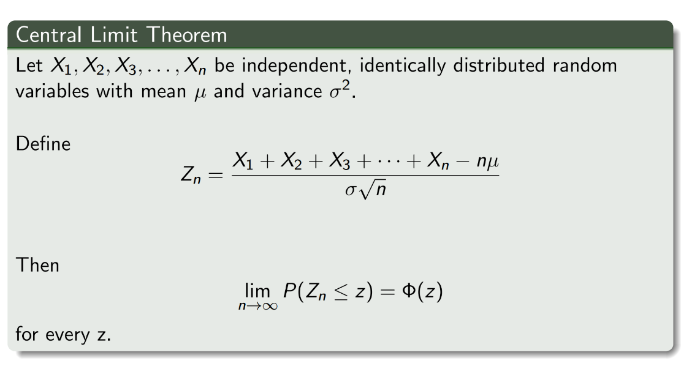
Central Limit Theorem
CS 355/555Probability and Statistics for Computer Scientists

Slide 7
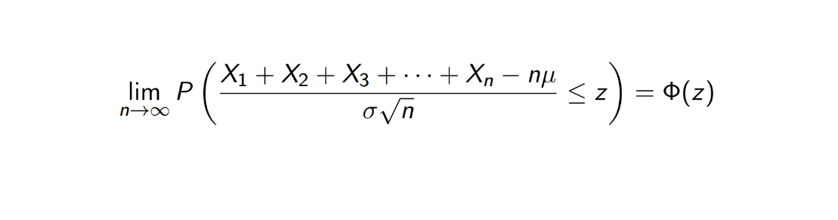
Central Limit Theorem
CS 355/555Probability and Statistics for Computer Scientists

Slide 8
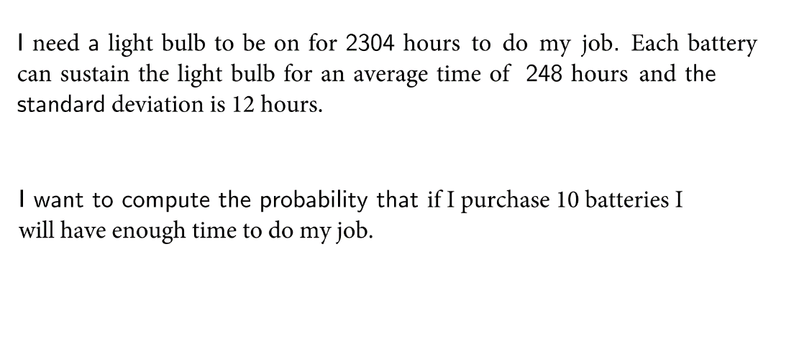
Central Limit Theorem
CS 355/555Probability and Statistics for Computer Scientists

Slide 9
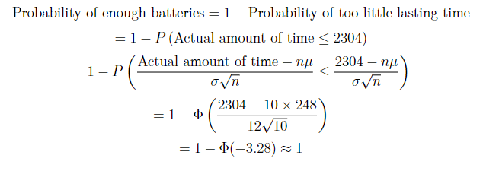
Central Limit Theorem
CS 355/555Probability and Statistics for Computer Scientists

Slide 10
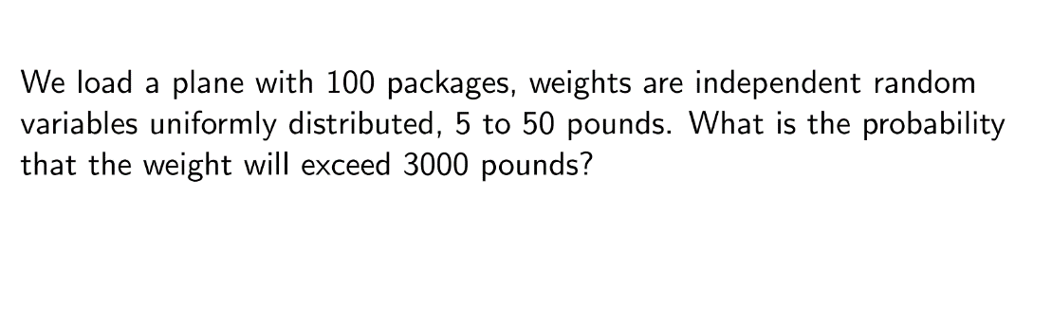
Central Limit Theorem
CS 355/555Probability and Statistics for Computer Scientists

Slide 11
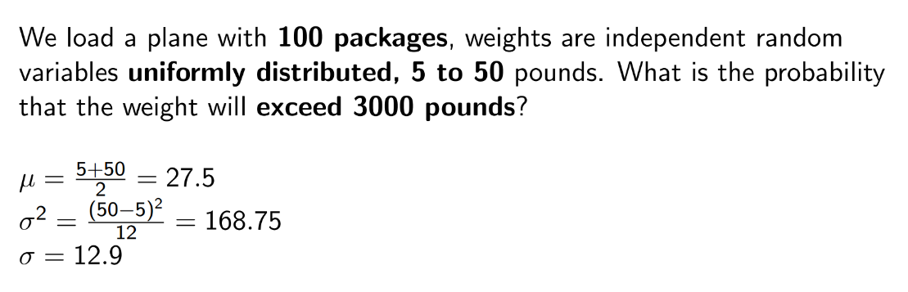
Central Limit Theorem
CS 355/555Probability and Statistics for Computer Scientists

Slide 12
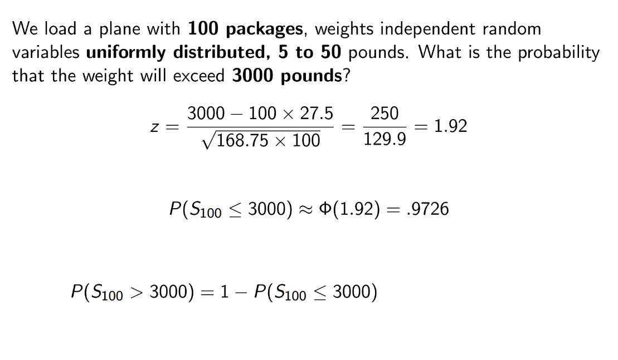
Central Limit Theorem
CS 355/555Probability and Statistics for Computer Scientists

Slide 13
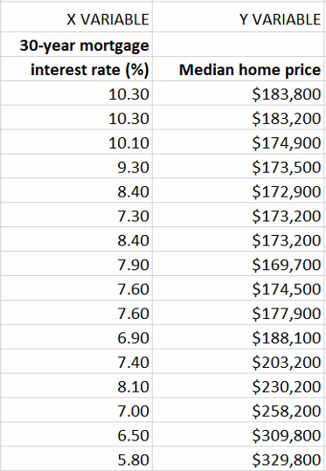
Covariance
If x changes, how y changes?
If I know x, how I predict y?
CS 355/555Probability and Statistics for Computer Scientists

Slide 14
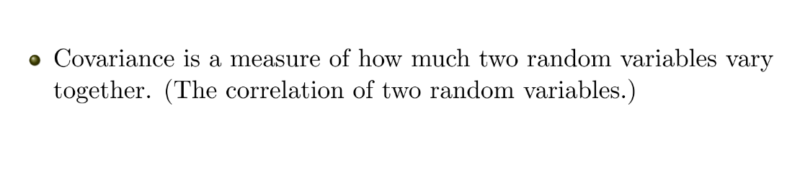
Covariance
CS 355/555Probability and Statistics for Computer Scientists

Slide 15
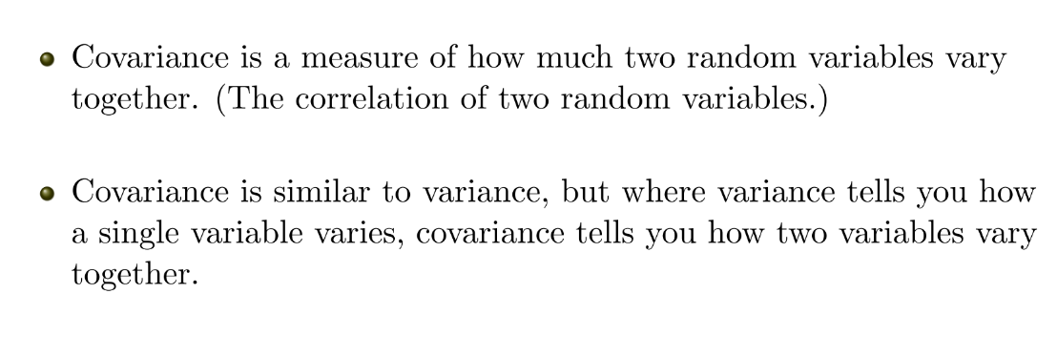
Covariance
CS 355/555Probability and Statistics for Computer Scientists

Slide 16
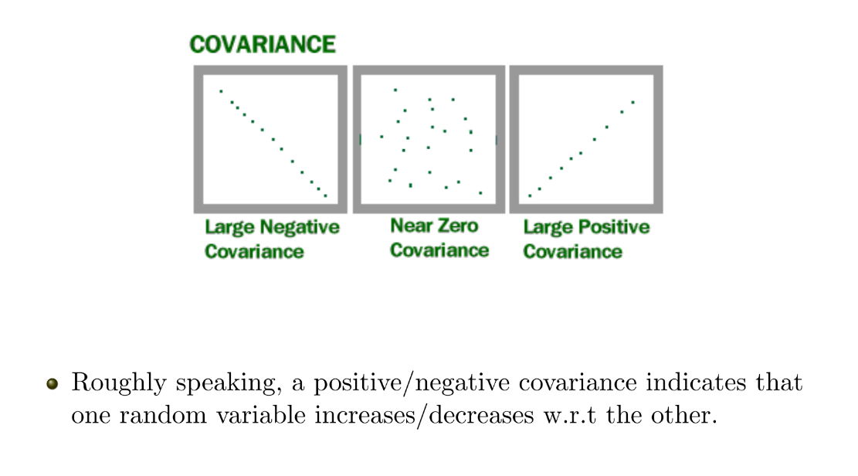
Covariance
CS 355/555Probability and Statistics for Computer Scientists

Slide 17
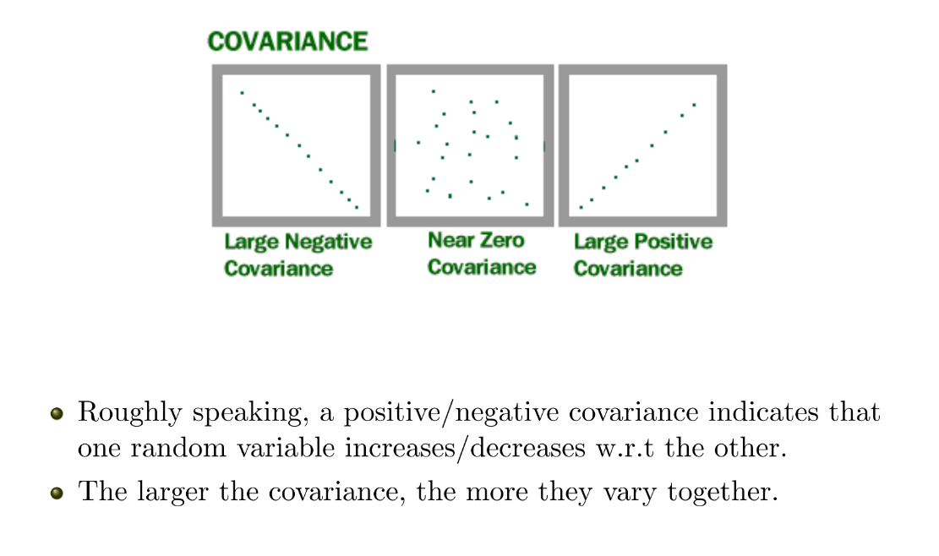
Covariance
CS 355/555Probability and Statistics for Computer Scientists

Slide 18
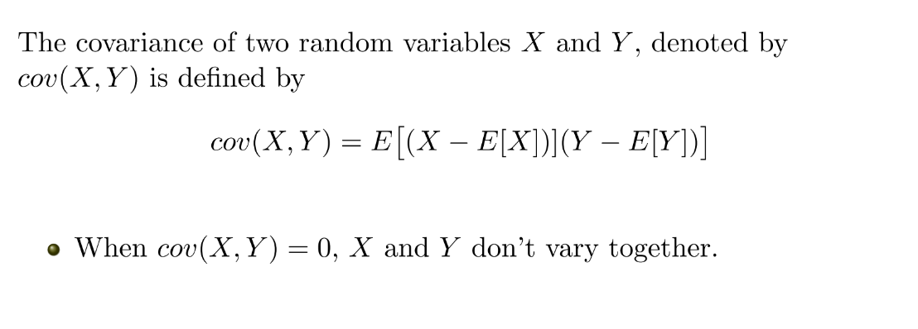
Covariance
CS 355/555Probability and Statistics for Computer Scientists

Slide 19
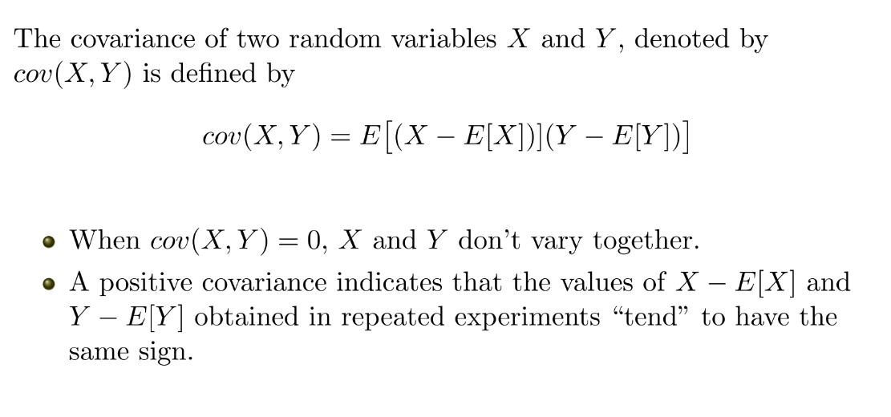
Covariance
CS 355/555Probability and Statistics for Computer Scientists

Slide 20
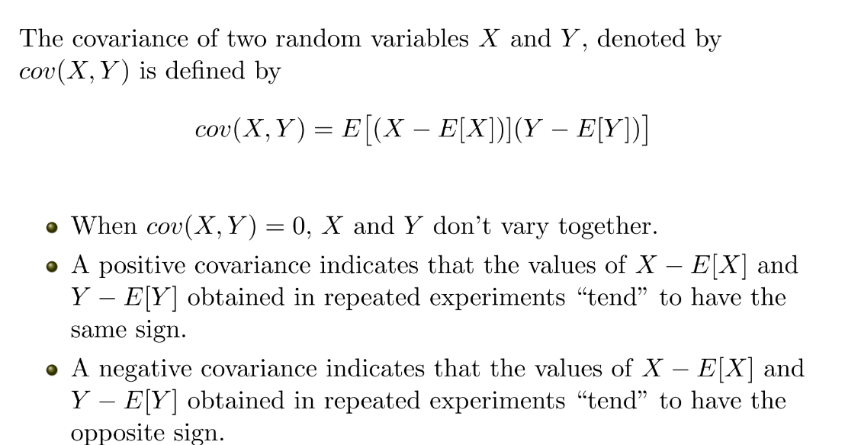
Covariance
CS 355/555Probability and Statistics for Computer Scientists

Slide 21
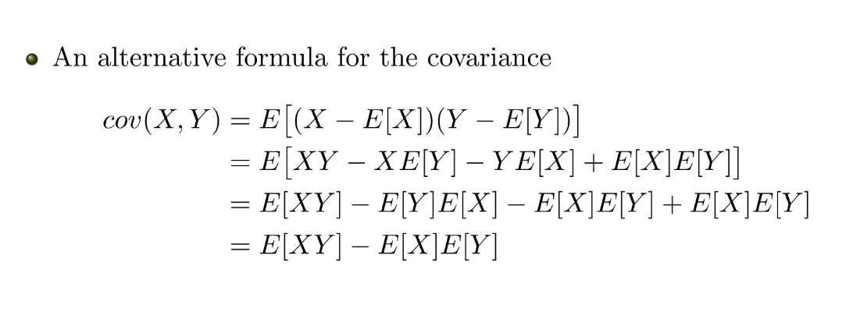
Covariance
CS 355/555Probability and Statistics for Computer Scientists

Slide 22
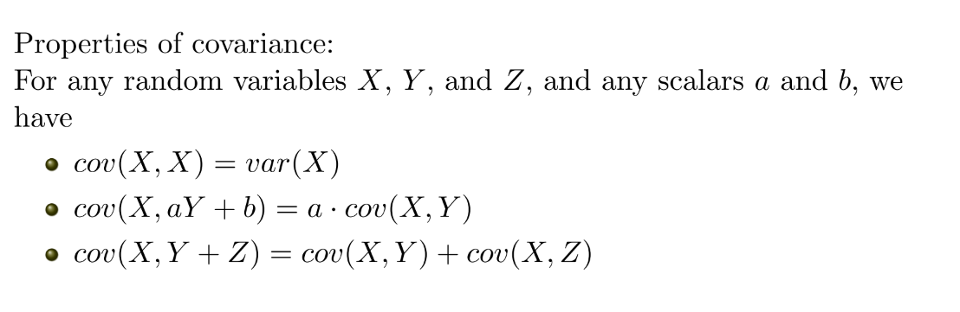
Covariance
CS 355/555Probability and Statistics for Computer Scientists

Slide 23
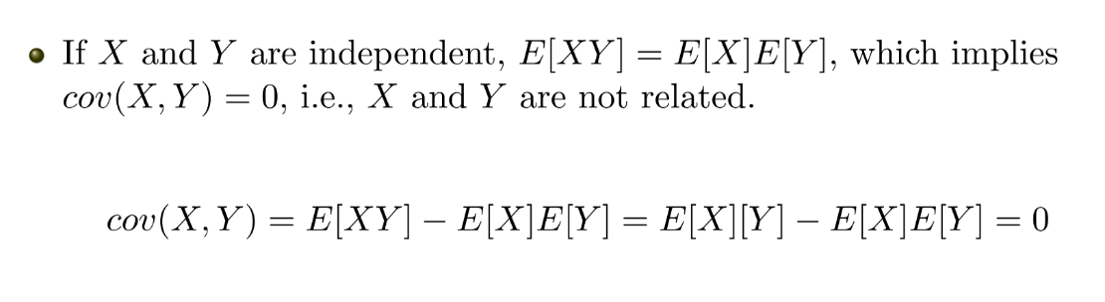
Covariance
CS 355/555Probability and Statistics for Computer Scientists

Slide 24
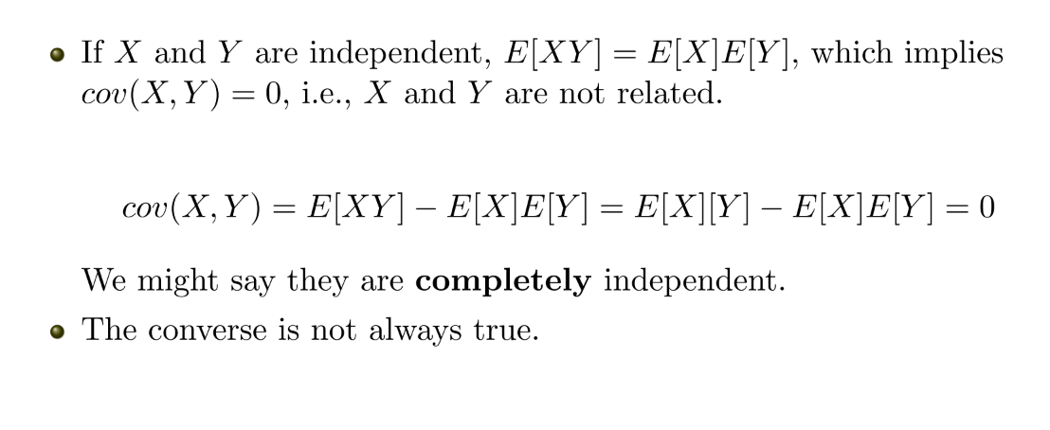
Covariance
CS 355/555Probability and Statistics for Computer Scientists

Slide 25
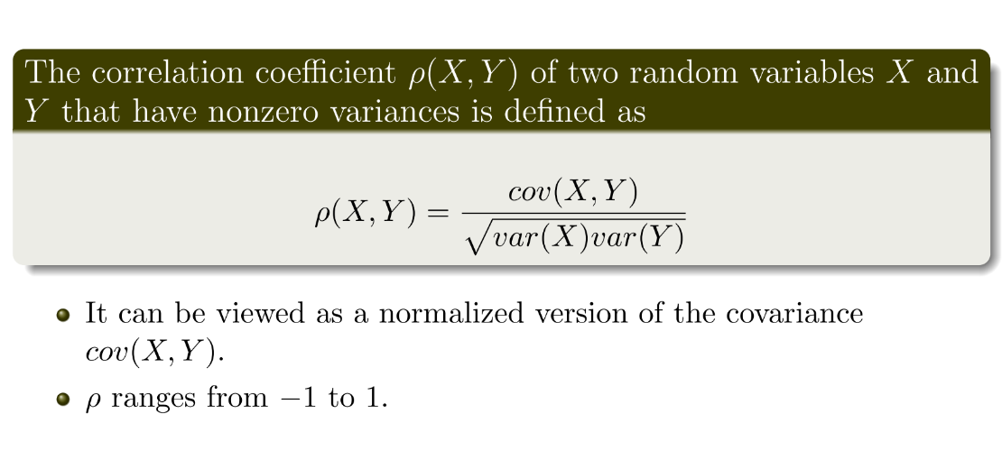
Covariance
CS 355/555Probability and Statistics for Computer Scientists

Slide 26
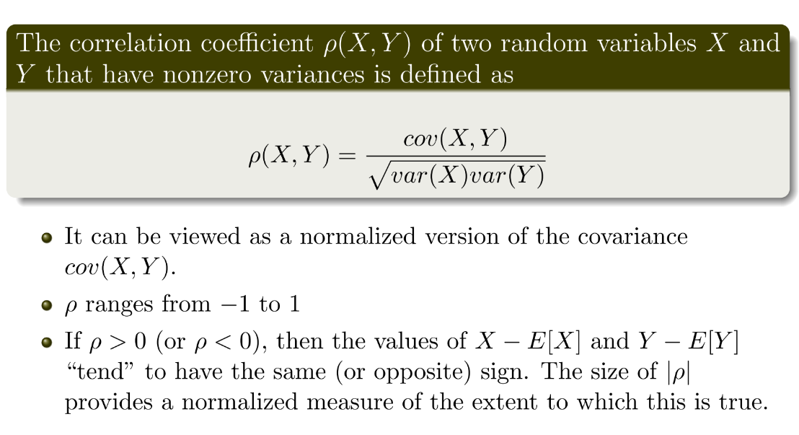
Covariance
CS 355/555Probability and Statistics for Computer Scientists

Slide 27
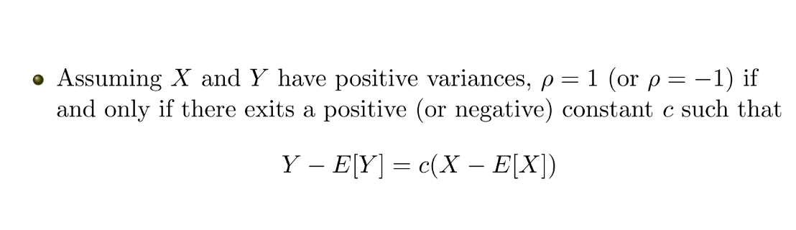
Covariance
CS 355/555Probability and Statistics for Computer Scientists

Slide 28
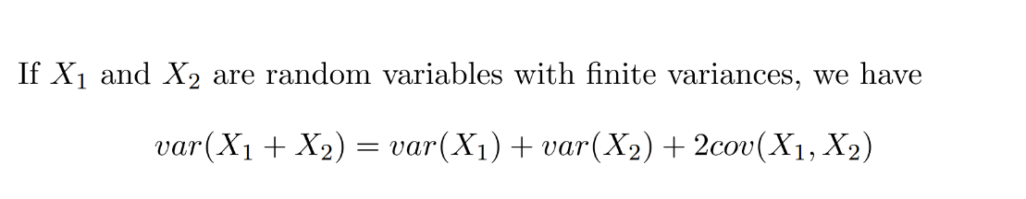
Covariance
CS 355/555Probability and Statistics for Computer Scientists

Slide 29
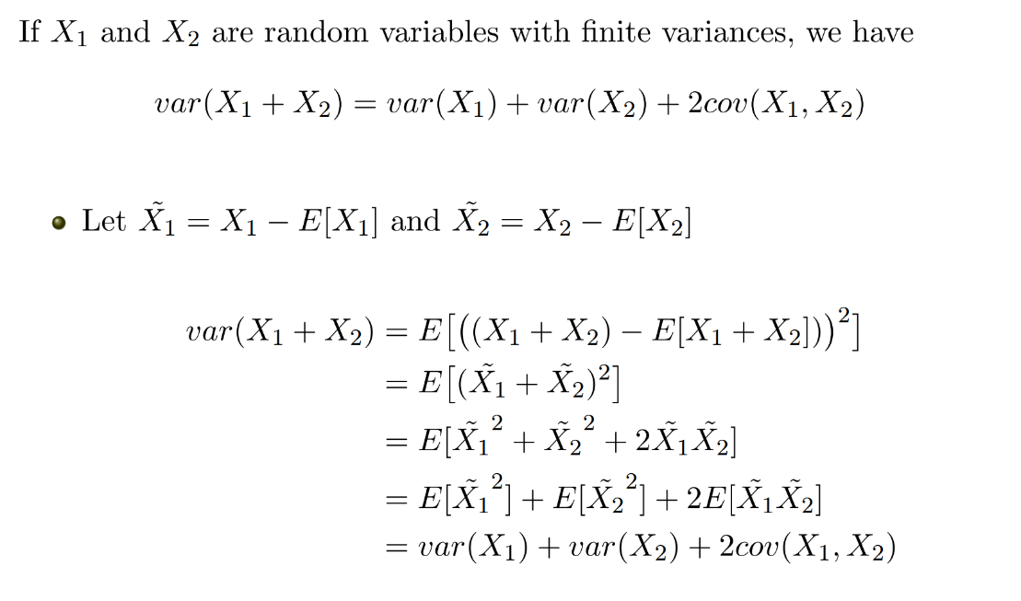
Covariance
CS 355/555Probability and Statistics for Computer Scientists

Slide 30
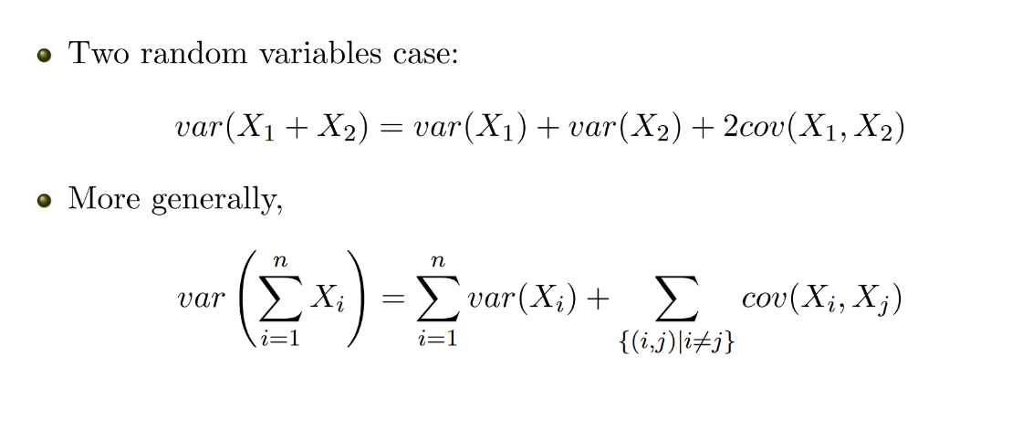
Covariance
CS 355/555Probability and Statistics for Computer Scientists

Slide 31
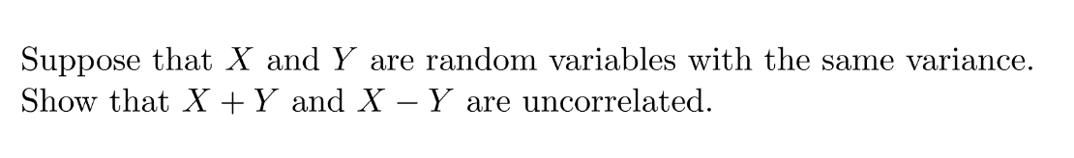
Covariance
CS 355/555Probability and Statistics for Computer Scientists

Slide 32
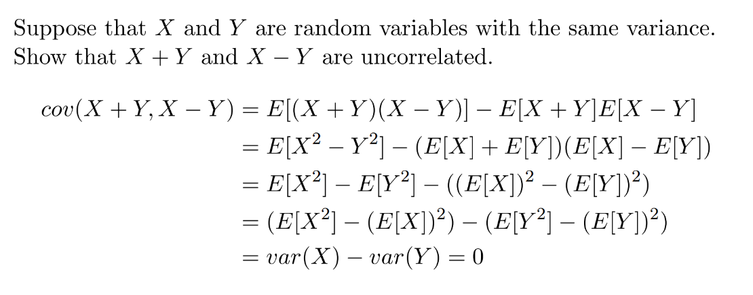
Covariance
CS 355/555Probability and Statistics for Computer Scientists

Slide 33
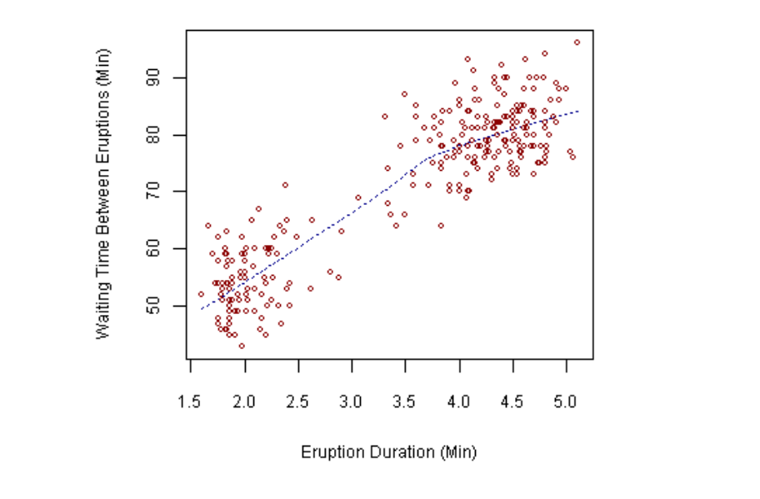
Linear Regression
CS 355/555Probability and Statistics for Computer Scientists

Slide 34
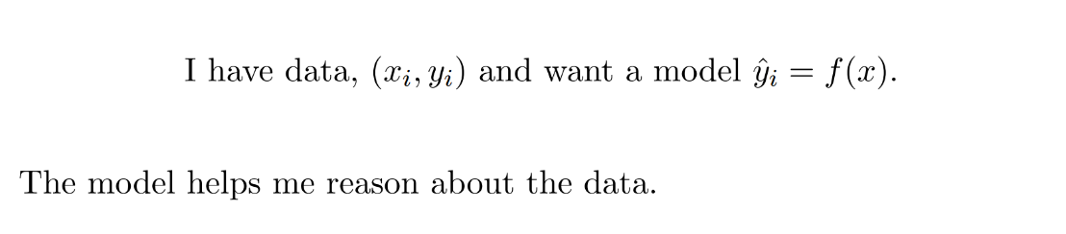
Linear Regression
CS 355/555Probability and Statistics for Computer Scientists

Slide 35

Linear Regression
CS 355/555Probability and Statistics for Computer Scientists

Slide 36
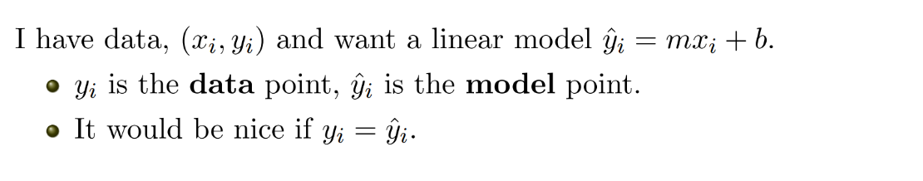
Linear Regression
CS 355/555Probability and Statistics for Computer Scientists

Slide 37
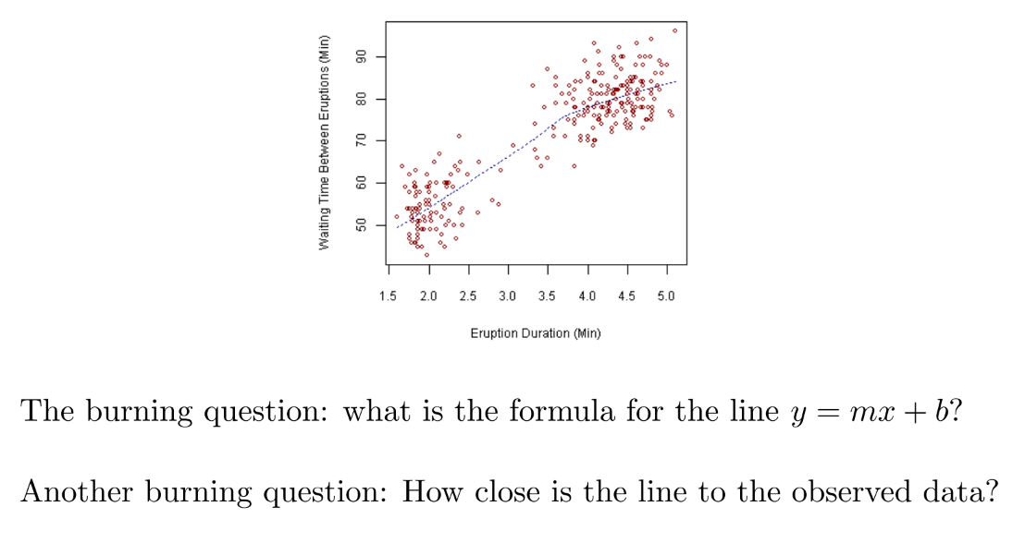
Linear Regression
CS 355/555Probability and Statistics for Computer Scientists

Slide 38
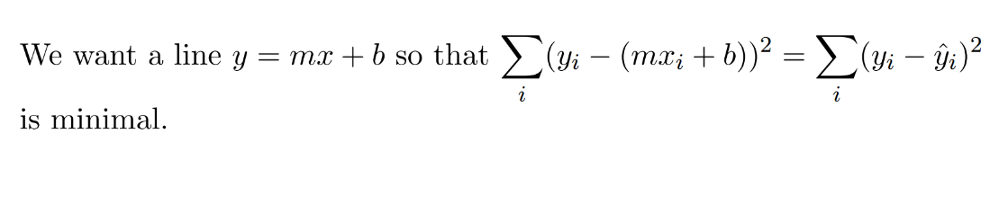
Linear Regression
CS 355/555Probability and Statistics for Computer Scientists

Slide 39
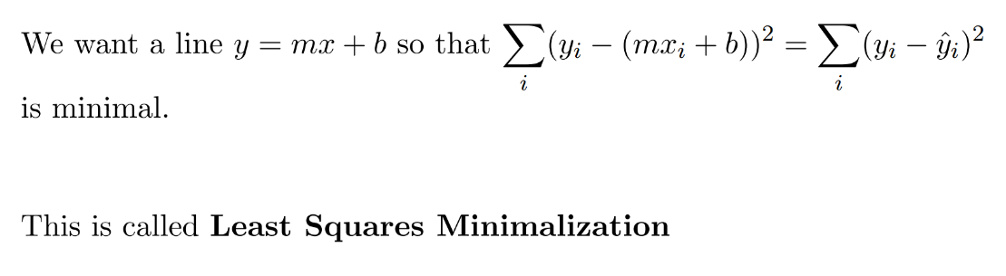
Linear Regression
CS 355/555Probability and Statistics for Computer Scientists

Slide 40
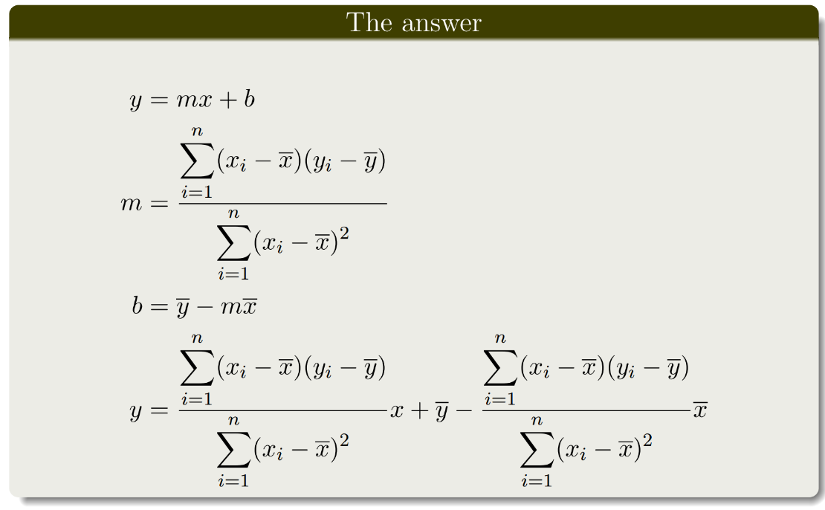
Linear Regression
CS 355/555Probability and Statistics for Computer Scientists

Slide 41
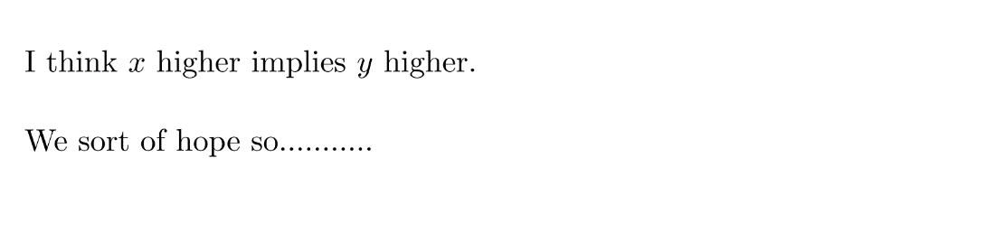
Linear Regression example
x: year, y: leaning tower of Pista
CS 355/555Probability and Statistics for Computer Scientists

Slide 42
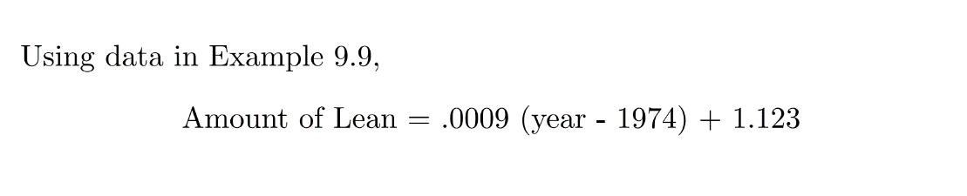
Linear Regression
CS 355/555Probability and Statistics for Computer Scientists

Slide 43
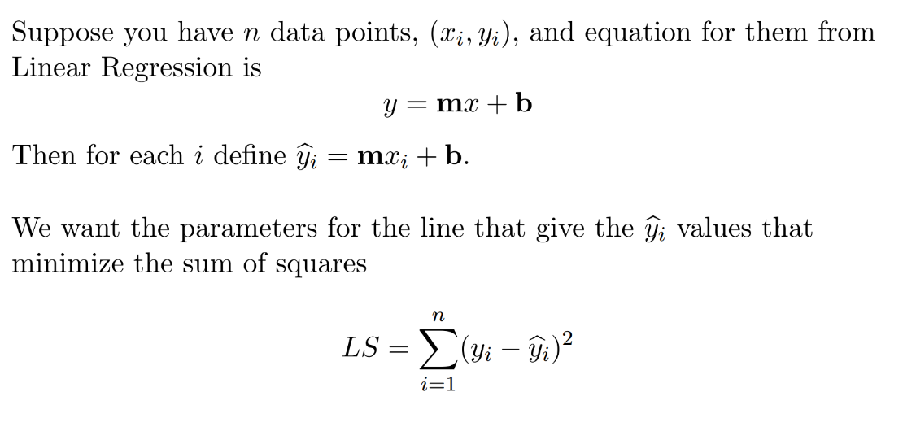
Linear Regression
CS 355/555Probability and Statistics for Computer Scientists

Slide 44
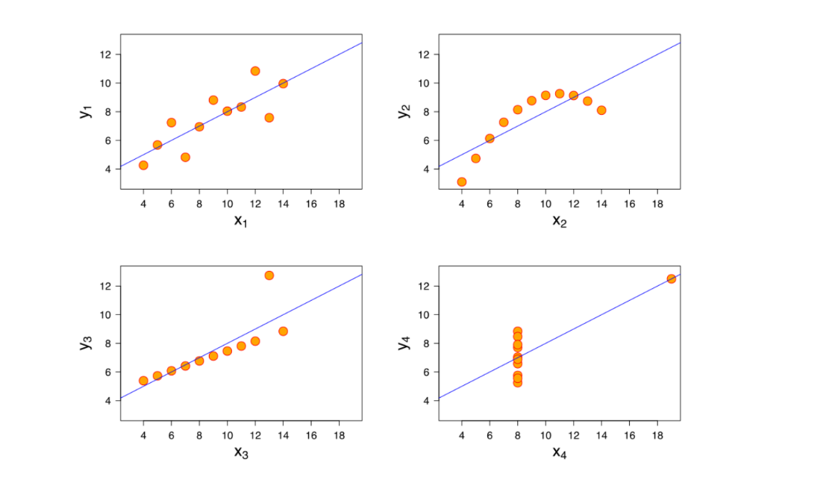
Linear Regression
CS 355/555Probability and Statistics for Computer Scientists

Slide 45
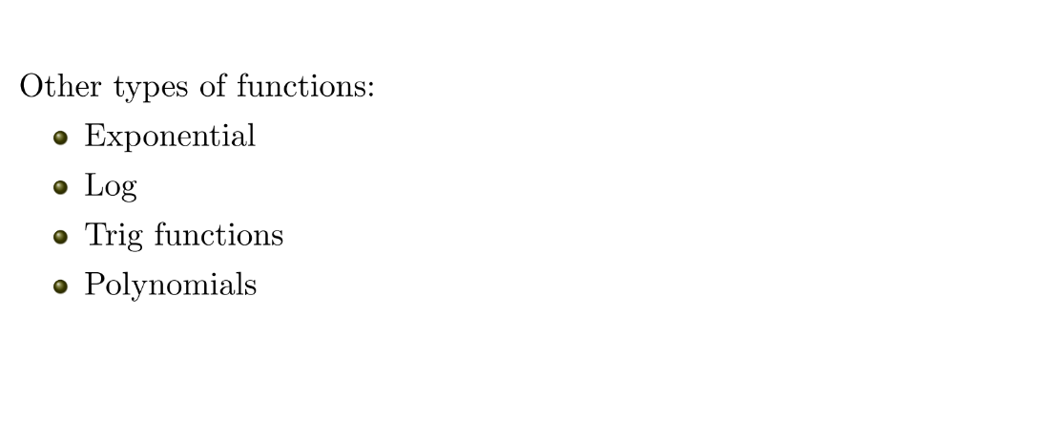
Linear Regression
CS 355/555Probability and Statistics for Computer Scientists

